Slide 1

Corporate Social Responsibility (CSR)
Student’s Name:
Institutional Affiliation:

Slide 2
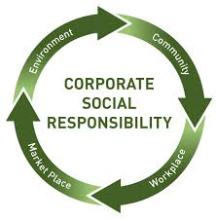
Introduction
This refers to set of actions executed by an organization to evaluate their operational impact.
This ensures positive foot prints on the community issues.
Notes:
CSR ranges widely from actions that deals with issues related to environment such as poverty and pollution to specific actions that are associated in business operations such as integrity and respect for personnel.
CSR contributes ethically and develops economically to enhance the quality of the life of the local community as well as the society.

Slide 3
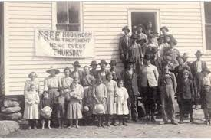
History of CSR
In mid 1800s, industrial criticism emerged on the working conditions.
The employment practices led to social problems such as labor unrest
Notes:
Andrew Carnegie was the first industrialist to make his fortune by donating part of his wealth for purpose of education and research
Howard Bowen official enacted the CSR among all the organization in 1953.
This led to development of social contract between community and firms where the business had obligation to contribute to the societal needs (Thomas Publishing Company, 2019).

Slide 4
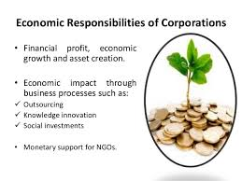
Economic Responsibilities
Business should use the available resources to produce goods and services.
The business practices should benefit not only the organization but also the community (He & Lai, 2014).
Notes:
Business or organization operating within our society should economically utilize the natural resources while conserving them such as water and production of energy.
The employees, vendors and community relations and engagement should be initiated to protect the community from any form of exploitation.
It is vital that labor standards are adhered to for instance, employment of minors or children should not be allowed.

Slide 5

Ethical Responsibilities
This changes over given time are on due to societal expectations.
Anti-corruption measures should be observed
Notes:
The organization should meet the expectations of ethical and social standards as well as having the capacity of developing ethical or moral standards.
It is the role of the community to ensure that integrity of the business operations is uphold and maintained. This guarantee efficient use of the natural resources while conserving the environment.
If a business draws a lot from the community, it has to create or make their own contributions to the society (Tai & Chuang, 2014).

Slide 6
Conclusion
It is important to define and implement CSR as it creates a good relation between the society and varying organization.
This not only enhances the image of the company but also, positive impacts in the community.
Notes:
Any organization that has well-defined social responsibility program can enhance the reputation, attract more clients and vendors.
CSR establishes a good platform for the businesses to elevate their reputations in perceptions of clients, customers community as well as the government.
Through CSR, all customer needs are met amicably with positive impact to the environment.

Slide 7
References
He, Y., & Lai, K. K. (2014). The effect of corporate social responsibility on brand loyalty: the mediating role of brand image. Total Quality Management & Business Excellence, 25(3- 4), 249-263.
Tai, F. M., & Chuang, S. H. (2014). Corporate social responsibility. Ibusiness, 6(03), 117.
Thomas Publishing Company. (2019). A Brief History of Corporate Social Responsibility (CSR). Retrieved 27 February 2020, from https://www.thomasnet.com/insights/history-of-corporate-social-responsibility/

Slide 8


